Slide 1
Shared IT Services DevOps transformation – Pilot selection and approach
Notes:
[]

Slide 2
What is DevOps ?
DevOps
Lean
&
Agile
Culture
Process
Automation
People
Technology
Notes:
represents a change in IT culture, focusing on rapid IT service delivery through the adoption of agile, lean practices in the context of a system-oriented approach
emphasizes people (and culture), and seeks to improve collaboration between operations and development teams
implementations utilize technology — especially automation tools that can leverage an increasingly programmable and dynamic infrastructure from a life cycle perspective
DevOps (a clipped compound of "software DEVelopment" and "information technology OPerationS") is a term used to refer to a set of practices that emphasize the collaboration and communication of both software developers and information technology (IT) professionals while automating the process of software delivery and infrastructure changes. It aims at establishing a culture and environment where building, testing, and releasing software can happen rapidly, frequently, and more reliably. [Wikipedia]

Slide 3
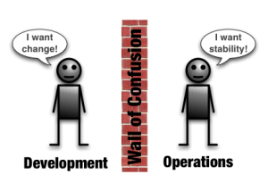
What is DevOps ?
DevOps is a response to the growing awareness that there is a disconnect between what is traditionally considered development activity and what is traditionally considered operations activity. This disconnect often manifests itself as conflict and inefficiency.
DevOps is an umbrella concept that refers to anything that smoothes out the interaction between development and operations.
Notes:
It’s safe to assume DevOps is offspring of agile software development
expanding agile benefits also into application release, deployment and operation
merging together developement and operation worlds

Slide 4
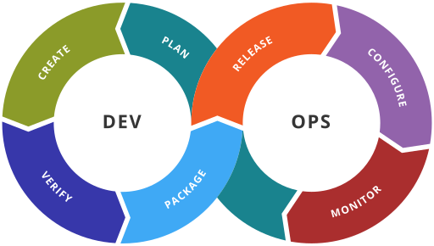
What is DevOps ?
DevOps is a cultural shift and collaboration (between development, operations and testing) and there is no single DevOps tool. It is rather a set (or "DevOps toolchain") consisting of multiple tools.
DevOps tools fit into one or more of the below categories which is reflective of key aspects of the software development and delivery process.
Notes:
http://dev2ops.org/2010/02/what-is-devops/ - good article about DevOps if more info needed

Slide 5
Why DevOps ?
Companies that practice DevOps have reported significant benefits including:
significantly shorter time to market
improved customer satisfaction
better product quality
more reliable releases
improved productivity and efficiency
increased ability to build the right product by fast experimentation
increased employee engagement
Notes:
DevOps is a powerful idea because it resonates on many different levels. It’s by no means a magical panacea, but if you can make DevOps work you it can help in removing barriers that are both a significant time-sink and a source of morale killing frustration.
DevOps enables the benefits of Agile development to be felt at the organizational level. DevOps does this by allowing for fast and responsive, yet stable, operations that can be kept in sync with the pace of innovation coming out of the development process.

Slide 6

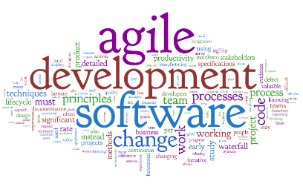
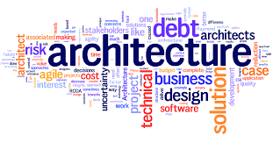
Where DevOps is applicable ?
SERVICE CATALOGUE AWARENESS
TRANSFORMATION COMMITMENT
CONTINUOUS IMPROVEMENT SPIRIT
AGILE PRACTITIONERS OR ASPIRING
NATURAL CANDIDATES
Notes:
Pilot selection criteria:
Java & .NET technology track to start with
In house developed apps, not COTS at this stage, preferably a web application
Pilots: avoid burden of firewall/perimeter protection -> intranet applications (Volvo CI/VCN)
Pilot team ready for the change and want to change !! Great role of TL and/or DM to support and drive the change

Slide 7
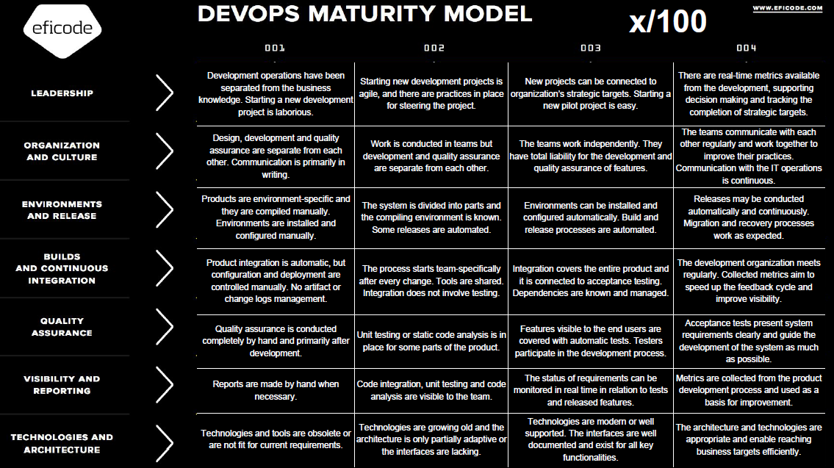
DevOps maturity levels
Notes:
Some level of maturity in the lean thinking is important criteria – so the transformation is not started from scratch.

Slide 8
DevOps Pilot scenario – Eficode work
1. Pilot team meeting
Team buy-in, agree on interviews and action plan
½-1 day, workshop, target team manager & team members
2. Perform interview & collect data
5 days, 5-7 persons interview + technical check, face to face
3. Build baseline and implementation plan
3 days, report on current state and prioritized roadmap
Presenting the plan for Volvo Group IT (project team, pilot team)
4. Decision: Go – No Go
5. Start transformation project
Define governance model, roles and targets

Slide 9
Roles and responsibilities
Eficode | Pilot team | Project team
Driver role |  | Observer role
Will assess the team and propose the next steps | Will actively participate in the pilot transformation | Will monitor the pilot project and learn based on the observations
Will start and drive the transformation project according to the agreed scope | Will document the observations and share with the project team | Will support the pilot project if required (ex. administration, communication..)
Will document the findings and results as well as share with the project team | Will support in designing the implementation approach for the next teams | Will document the observations in order to produce the methodology for further concept roll out and and design the implementation approach

Slide 10

Key message
The purpose of the pilot project is to help in understanding how DevOps concept can be useful for Volvo Group IT and how it can be delivered.
It is important that Pilot team closely cooperates with both Eficode and Project team as well as document and share the findings.
Project team will support in all the transformation activities (ex. Communication, administration..)
1 project member assigned to each pilot project and supporting the activities.

Slide 11
DevOps pilots
We would like to transform selected teams with a help of the external company Eficode. This would help us to produce artifacts and document the transformation methodology for further concept roll out.
High level approach
Pilot identification & Buy-In
Baseline and impact analysis
Build implementation plan and start transformation project

Slide 12
DevOps Pilot scenario – Eficode work
1. Pilot team meeting
Team buy-in, agree on interviews and action plan
½-1 day, workshop, target team manager & team members
2. Perform interview & collect data
5 days, 5-7 persons interview + technical check, face to face
3. Build baseline and implementation plan
3 days, report on current state and prioritized roadmap
Presenting the plan for Volvo Group IT (project team, pilot team)
4. Decision: Go - NoGo
5. Start transformation project
Define governance model, roles and targets
Notes:
Important to know that duration of the implementation phase might be different. Depends on the maturity level.

Slide 13

Our expectations and more info
Pilot team eager to accept the change and ready for it, need to secure enough time for the change process and work with Eficode consultant
Good support from the managers in driving thru the change
Documentation of the observations and results, lessons learned
Project team will support you in the transformation process
Eficode service cost is covered by DRS
Notes:
Project support – communication, templates for documenting results, etc.
What is pilot team expectation?

Slide 14
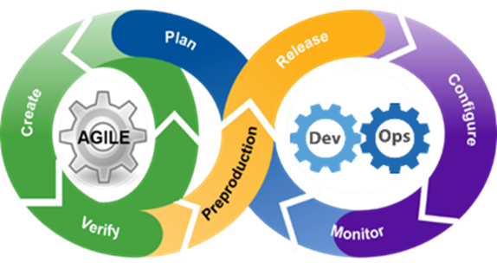
Key message
DevOps is a culture shift or a movement that encourages great communication and collaboration (aka teamwork)
DevOps extends Agile
DevOps gains momentum from VPS4IT (Lean)
DevOps brings tangible benefits (TDM evidence – next slides)
We would like to run a pilot to produce methodology to repeatedly reap the benefits of DevOps

Slide 15
TDM before Devops
Ticket based communication (takes 2 minutes to create simple ITSM ticket)
Long reaction time (15 minutes for incidents, hours for change requests)
No automation = human errors
Complex setup with unclear configuration ownership
Blame games
Notes:
It is important for operations to know details of the delivery – what it does, how it behaves. With ticket system – you never know who will pick it up.
Reaction time: you need to create the ticket, sometimes with detailed instructions. Then someone need to pick it up, understand it and deliver. In most cases the whole process takes much longer than performing the task.
Human errors are common as we are working with names and values impossible to spell (grapdp01, grapdt01)
In case of incidents, blame games were quite common. Dev team say: application is now working due to poor infrastructure. Operations say: you poorly writtne applications makes the whole environment unstable.

Slide 16

TDM before Devops
Different runtime and development environment required „polishing” the application before it could be deployed.
Notes:
Having different runtime and development environment always leads to problems while rolling out changes. Some errors are difficult to detect which results in production incidents.

Slide 17
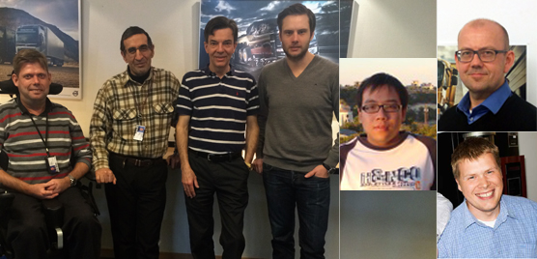
ADC-J

Slide 18
TDM after Devops
DEV and Ops working together, sharing responsibilities
Fully automated release process - deployment takes up to 2 minutes
Instant reaction in case of incidents.
Improved skills for all team members
Modern development and runtime environment supporting agile techniques – great place to work
Equal development and runtime environments
Notes:
As a result of Development and Operations team working together we achieved to create runtime environment with fully automated configuration and release process.
Now full application redeployment takes less than creating ITSM ticket.
Sharing responsibilities gives all team members equal access rights, so in case of incident we are able to react immediately.
Using modern tools like Jboss AS, Jenkins, Sonar, testing frameworks makes TDM a great place to work for developers and administrators, and we are constantly looking for improvements.

Slide 19
TDM after Devops
After server delivery and initial system setup almost all tasks can be performed by developers
Higher responsibility = higher quality + higher skills
Conformity to Global and Volvo standards
Before DEVOPS we spent 3 MSEK for migrating 1 application.
ADC-J consumed 3 MSEK and with DEVOPS approach we migrated 11 applications.
Notes:
After initial setup done by operations, developers are able to perform rest of configuration – operations team have more time for improving the environment
Higher responsibility brings and full access rights brings in higher quality an skills improvement. Developers are no longer afraid to modify runtime environment. Operations team has new tools to better control the environment.
All environment components are conforming to Global and Volvo standards.

Slide 20

Questions
Contact: Chairman: Bartosz Celmer (Volvo)
Project Manager: Marcin Klimkiwicz (Volvo)

